Slide 1


Sets
project from team
localhost

Slide 2
01
Roles
02
What is a set?
03
About the project
04
Used applications
04
Code

Slide 3
Roles
Martin Sevov
MS
 | Back End
Alexandra Laleva
AL
 | Front End
Vasil Stanchev
VS
 | Scrum Trainer
Boris Kanev
BK
 | Front End
Georgi Mihov
GM
 | Code Check

Slide 4
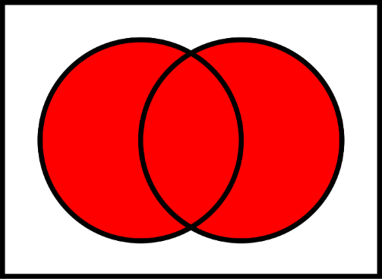
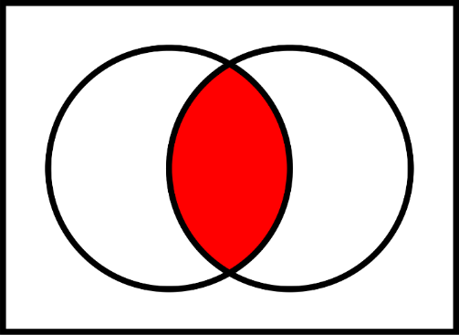
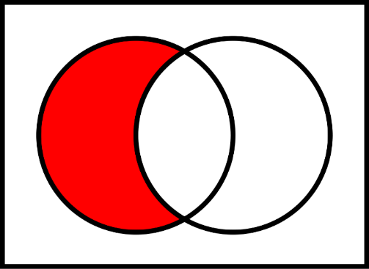
What is a set?
Unions
A set is a well-defined collection of distinct objects.
There are several fundamental operations for constructing new sets from given sets:
Unions - Two sets can be “added” together. The union of A and B, denoted by A ∪ B, is the set of all objects that are members of either A or B.
Intersections - A new set is constructed by determining which members two sets have "in common". The intersection of A and B, denoted by A ∩ B, is the set of all things that are members of both A and B.
Complements – Two sets can also be “subtracted”. The relative complement of B in A, denoted by A \ B
Intersections
Complements

Slide 5


Used applications
 | VS
The IDE used
 | GitHub
For source control
About the project
We had to create a C++ program
which represents the operations
on sets realized as arrays where
the user can define the number of elements in the array, as the
elements have values you choose.

Slide 6
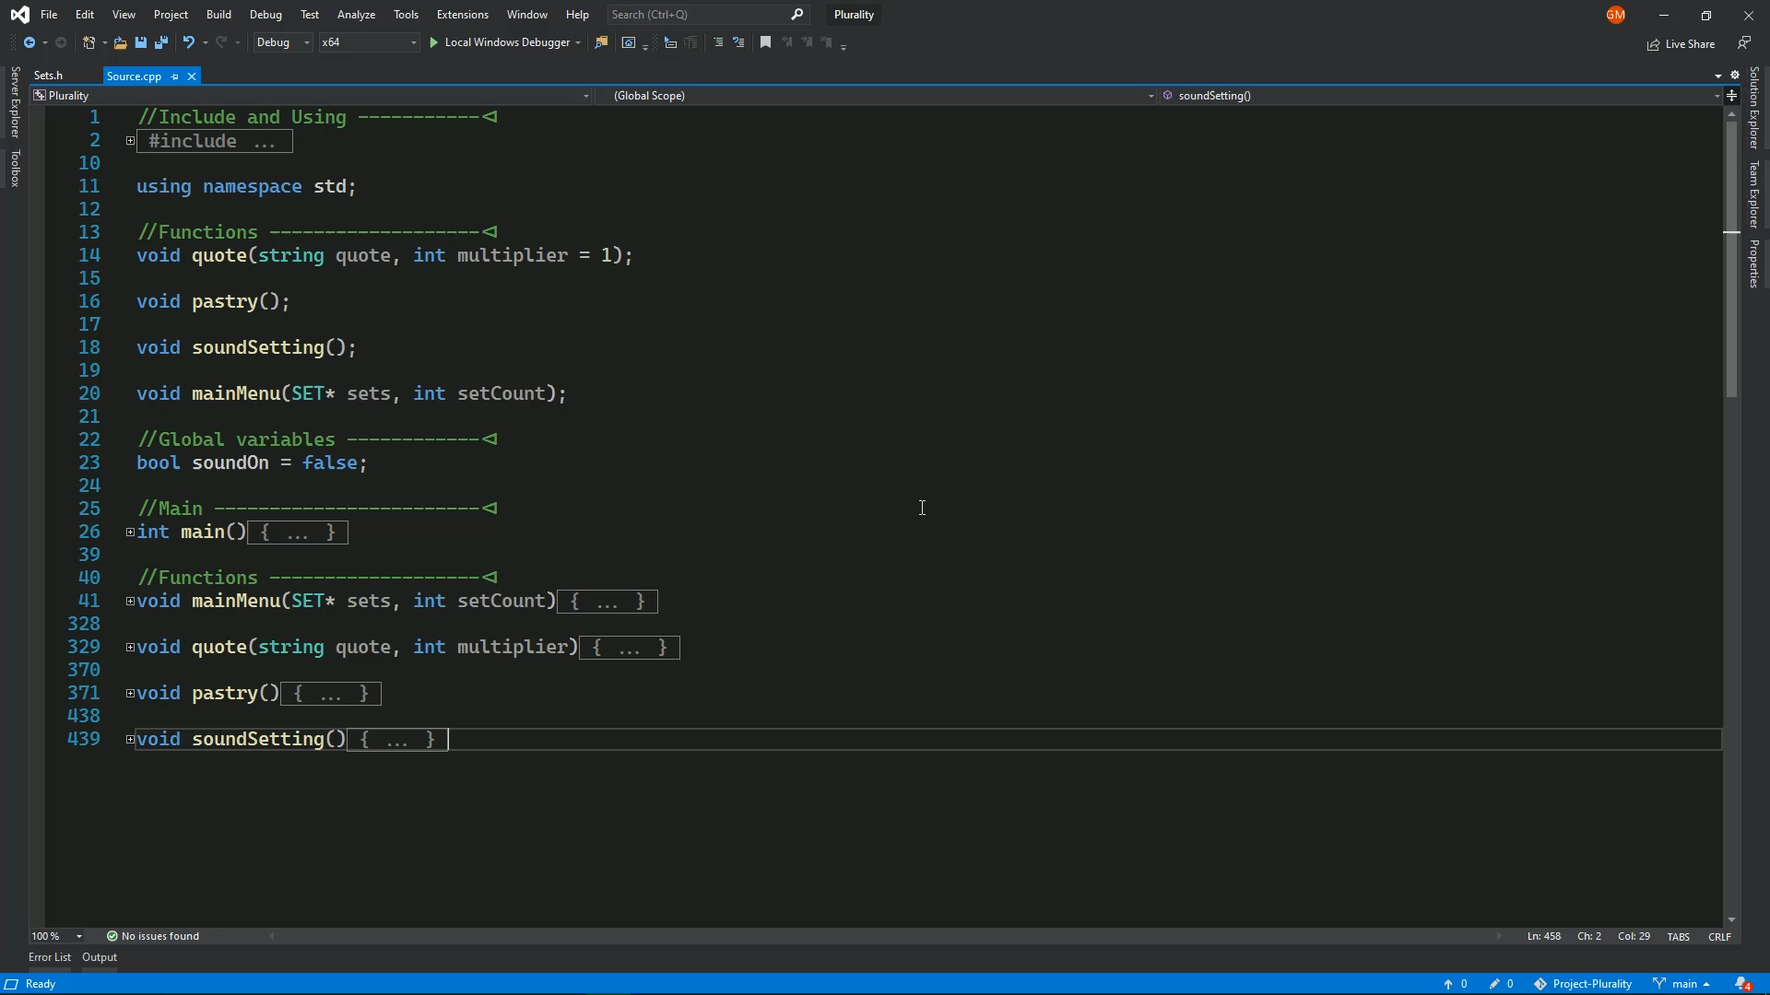
Code
The code is separated into two files:
Source.cpp, Sets.h
There are a few
Easter eggs, made
for fun ☺
A brief video
showcasing the
functions >

